Slide 1
Timelines & Roadmaps
Week 3 – Lecture and Workshop Slides COMP 3014

Slide 2
Today’s session’s
Extract our user stories
Overview of timelines and roadmap
Get some 1-2-1 feedback on you plans so far
Notes:
>> Before that

Slide 3
Can you open and log into:
Miro
We’ll need this for the review session and for our journey map.
You’ll use the same board your mind map is on.
Trello
We’ll be using this as we go along.
Teams
Just ‘cause.
Last weeks weekly post thread
This will be helpful for the review

Slide 4
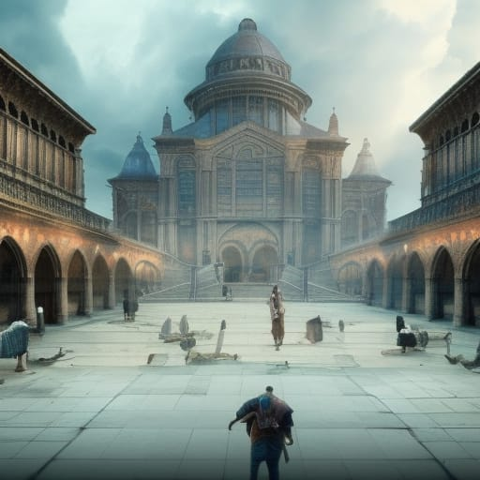
Register
It’s time to register for class.
“Students register their attendance” https://creator.nightcafe.studio/creation/SKkLdAX75aId4Y31P6OK

Slide 5
Engage
1
We started a few things last week. . .

Slide 6


Forum Posts
Notes:
Was this a smart goal?
Did you know enough to do it?

Slide 7
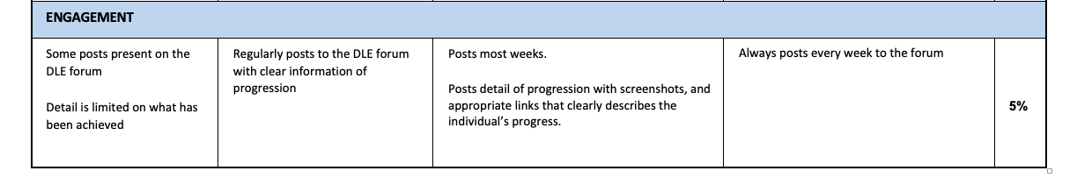
Notes:
Engagement will drive the strategy plan.
There is more value to it than 5%. It’ll improve the 95%

Slide 8
Take a peek & comment
Look through last weeks posts.
Comment on a couple where you:
Saw a good idea
Saw something you’ll integrate into your documents
Notes:
Could be your 3013 game
Could be something for a pervious module
Could be your personal brand and portfolio In order to do that. . .

Slide 9
Any
Comments?
Notes:
Was this a smart goal?
Did you know enough to do it?

Slide 10

Which should lead to. . .

Slide 11
User Stories
2
Let’s develop our user stories

Slide 12
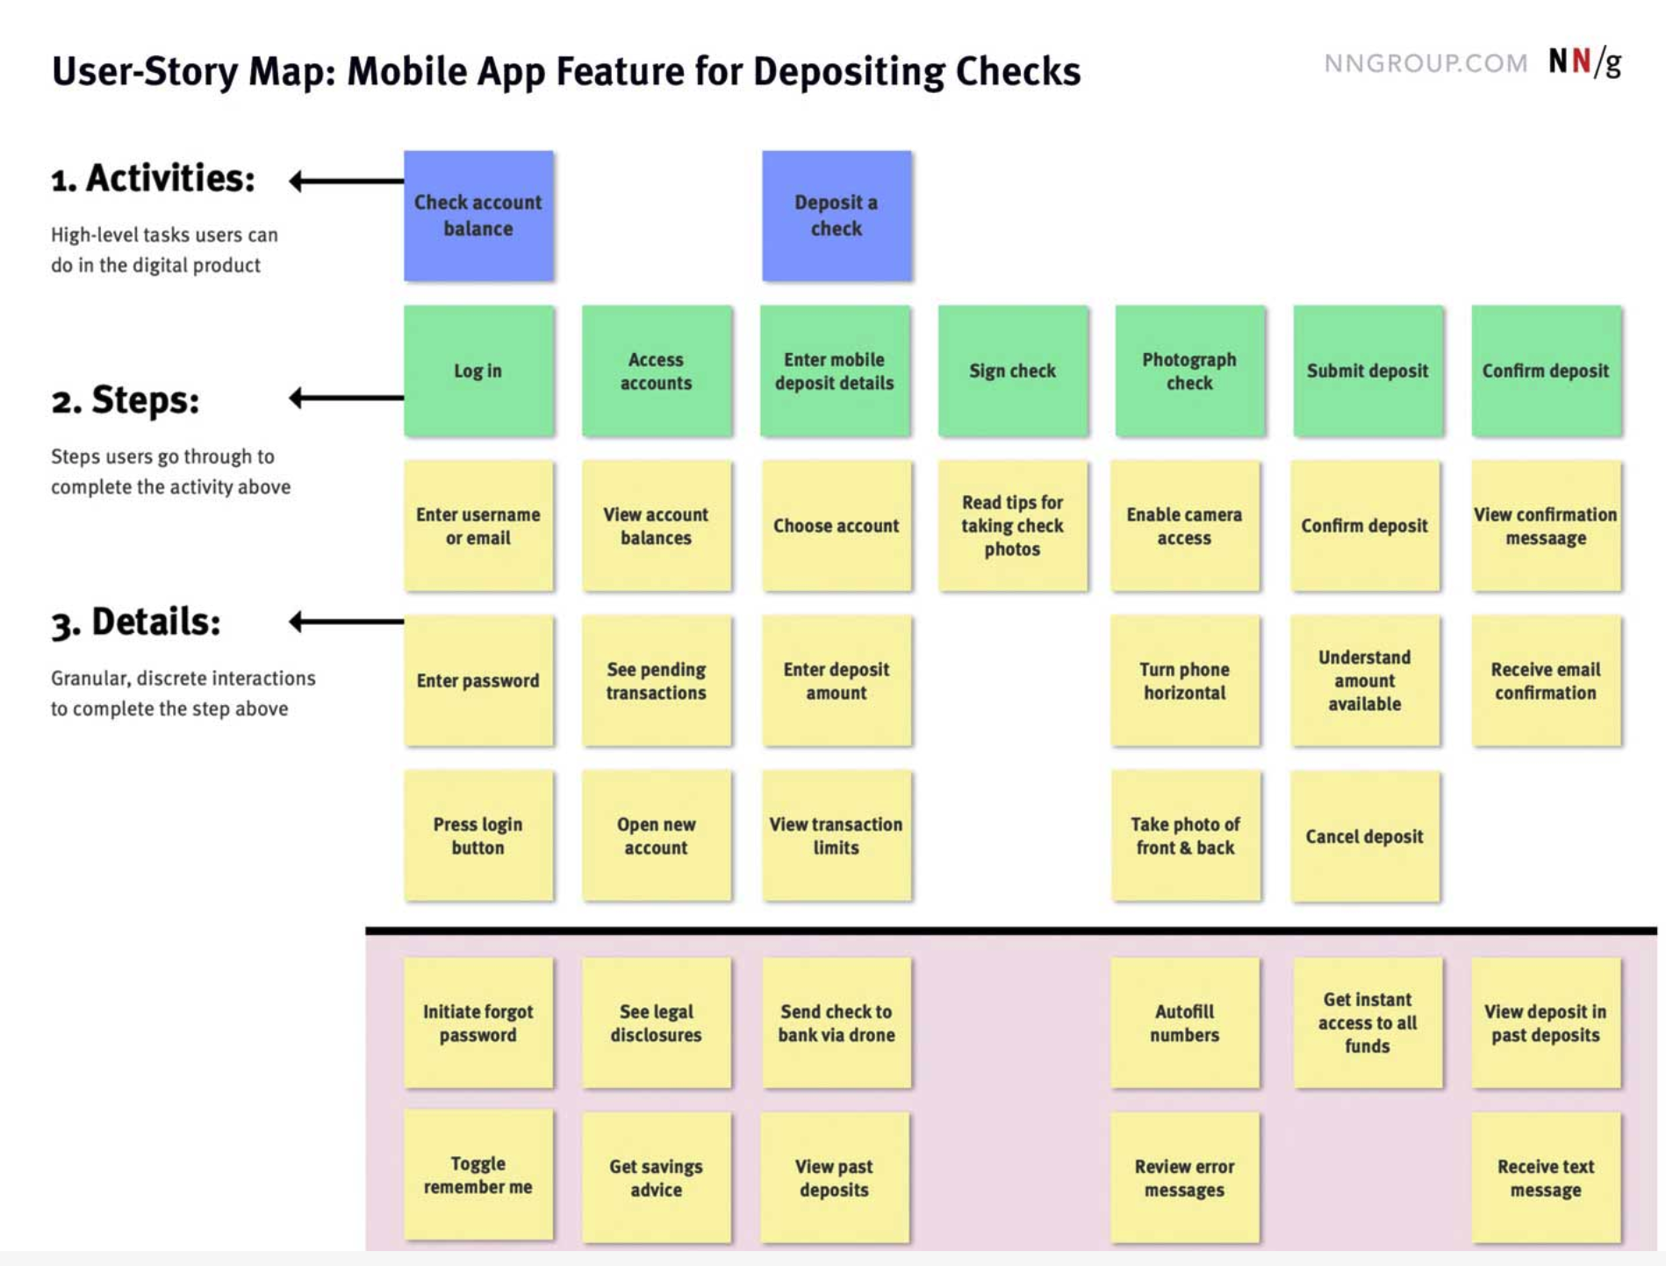
User Story
Map
Notes:
A way to map task to goals

Slide 13
Hopefully, you have:
Epics
The highest level activity or goal that needs breaking down.
User Story
The mid level steps you need to take to achieve your goal.
Tasks
The detail of how you’ll incrementally move towards your goal.
And some SMART goals starting to form

Slide 15
https://miro.com/app/board/uXjVPtXX6-I=/
Notes:
https://miro.com/app/board/uXjVPtXX6-I=/

Slide 16
A user story is an general explanation of a software feature written from the perspective of the end user or customer.
The purpose of a user story is to articulate how a piece of work will deliver a particular value to the customer.

Slide 17
A user story is an general explanation of a goal written from your perspective.
The purpose of a user story is to articulate how that goal will deliver a value to yourself.

Slide 18
Why?
You’ll use them lot’s in industry
Forces you to think about your goals from a different perspective
Good excuse to play with ChatGPT (if it’s working)
Notes:
You’ll use them a lot in industry, so it’s good to practice.
They force you to

Slide 19
User Story
As a {persona}
I want to {achieve a goal}
So that {an outcome is reached}
Activity / Discussion Write a user story for an every day activity
Notes:
- Big mac as example

Slide 20
What questions do you have?
?

Slide 21
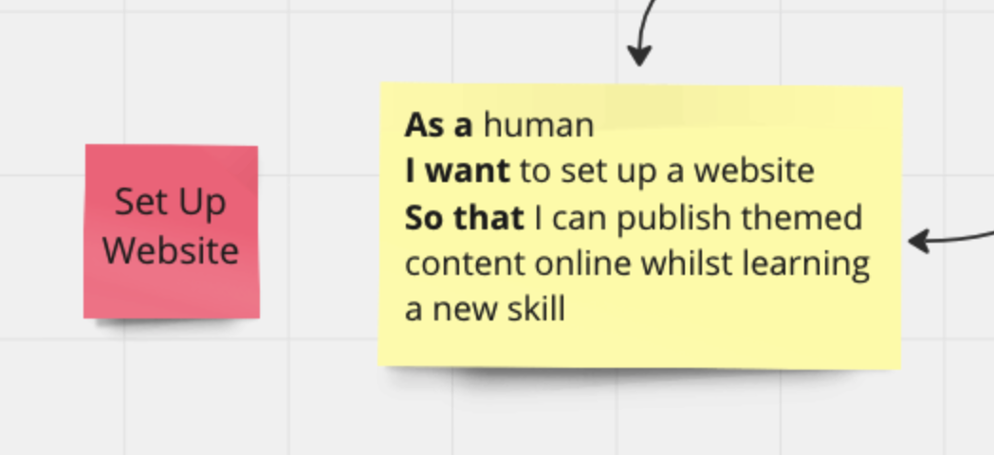
User Story
As a {persona}
I want to {achieve a goal}
So that {an outcome is reached}
Activity Take your user stories post-its and develop them into full user stories as per the example above. (copy the post-its. . . don’t move them from your user story map!)
Notes:
- Share GPT script in teams

Slide 22
Your mission is to. . .
Get up
Pair up with someone not on you team
And discuss a couple of user stories you’ve created.
Think about
- Do you understand the goal after reading the other persons user story? - What unknowns are know about for your own? - What is the first step you’d take towards the goal?

Slide 23

Break?

Slide 24
Arrange yourselves in a standing horse shoe.
Notes:
- Add submission dates

Slide 25
Timelines & Roadmaps
3
Let’s develop the time dimension

Slide 26
Question:
Thinking of uni as a whole (not just this module), how do you allocate and track your time?
Notes:
https://miro.com/app/board/uXjVPtXX6-I=/

Slide 27
You’ll need to develop two things:
A timeline
A high level, 12 month view of your plans. (10,000 foot view)
A Roadmap
A more detailed version of the timeline, focusing on what you’ll deliver this semester.
We’re using two terms to distinguish between different ‘zoom levels’ for a Gannt chart.

Slide 28
Warning!
We’re going to cover these at a very high level today.
It’s expected that you’ll do some research into these tools to develop your understanding.
Notes:
You just need to know enough to get the job done. 80/20
The videos I’ll point you at

Slide 29
There’s a great video course on LinkedIn Learning I’ll point you towards. It’s got everything you need to know about Gannt charts in ~25 mins.
I’ll also point you at two ‘doing’ examples for using Excel.
Feel free to use a completely different tool.
Notes:
https://miro.com/app/board/uXjVPtXX6-I=/

Slide 30
What is the purpose of a roadmap?
A visual representation of a plan.
Forces the project manager (you) to consider time when planning.
Makes it easier to spot dependent tasks / activities.
Will help you spot missing items from your plan
Notes:
- Get suggestions from the class

Slide 31
But most importantly (and to repeat) . . .
It required you to consider how long each individual task you’re going to do will take.
You only have 12 hours a week assigned to this module! This is where you decide how you are going to use it.
Notes:
You might think I’m being repetitive with the 12 hour thing
When you start work, you only have N hours a week to get your tasks done.
YOU will have to decide on the detail

Slide 32
We’re about to watch a video Arrange yourselves accordingly
Notes:
- Add submission dates

Slide 33
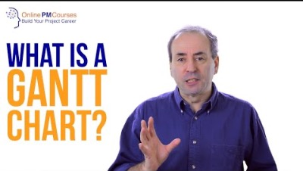

Slide 34
The Timeline
This is when Tony opens Excel.
Notes:
e

Slide 35
Build a basic timeline
Open Excel
Save a new workbook to your 3014 folder.
Add the heading and epics
Sketch out your timeline.

Slide 36
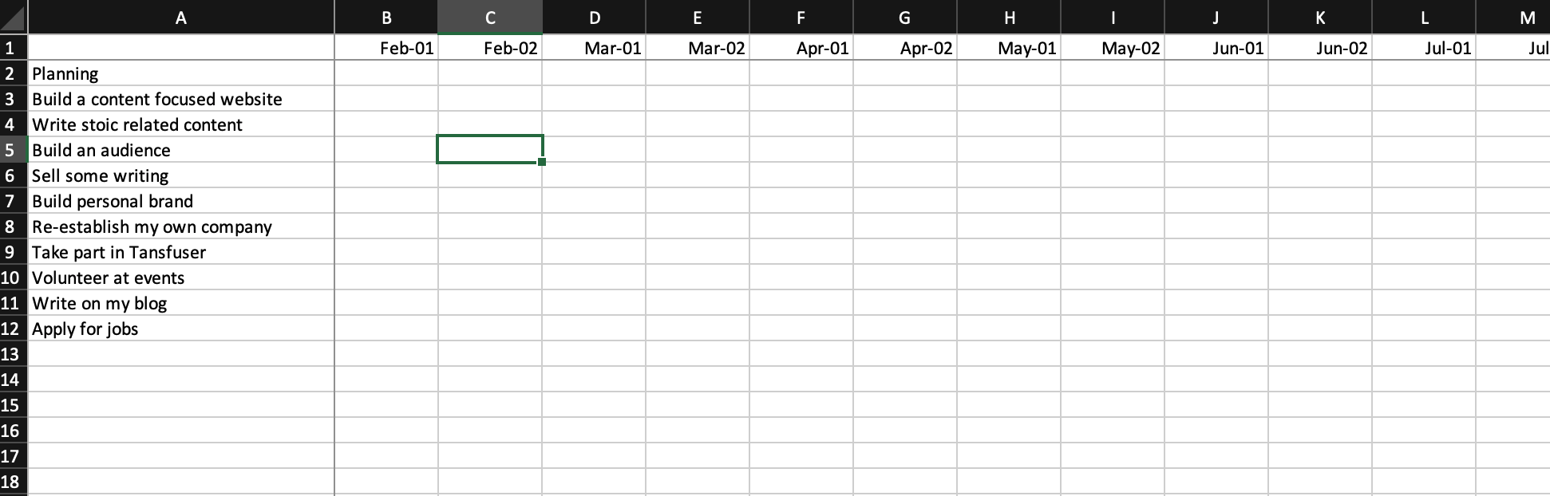

Slide 37
The Road map
This is when Tony opens Excel. Again.
Notes:
e

Slide 38
Start your roadmap.
Add a second sheet
Call it something snazzy. . . like Road Map
Add your user stories under each epic
Sketch out your roadmap

Slide 39
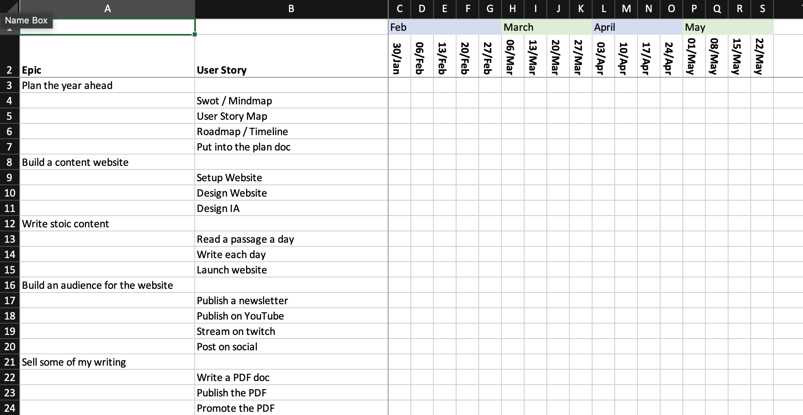

Slide 40
Start to work on your roadmap.
You might want to start by estimating how long the most critical user stories will take.

Slide 41
Feel free to dive deeper into your plan.
As mentioned, we’ve looked at this at a really high level
Notes:
- no epics, tasks in stead
- Time estimation

Slide 42
Ideas Share
Notes:
e

Slide 43
In Teams channel, share:
Any events you’ve found.
Any courses you’re going to look into.
Tools you’ve found useful.
Anything else that is going to help on your journey.
Notes:
- Get suggestions from the class

Slide 44
Lunch?

Slide 45
Video feedback
Marketing has asked for a favour. . .

Slide 46
ICONIC
Take a look at the ICONIC project ICONIC : https://www.plymouth.ac.uk/research/centre-for-health-technology/iconic
https://www.oberlo.co.uk/blog/smart-goal-examples
Notes:
https://www.plymouth.ac.uk/research/centre-for-health-technology/iconic

Slide 47
https://vimeo.com/feralfilmuk/review/797076085/947316313b
Notes:
what works, what does not work, what needs changing?

Slide 48
How’s your work gone so far?
What’s working? What confusing? What’s making you shout at the computer?

Slide 49
Revolving feedback
I’m going to work around the room until the end of the session, spending a few minutes with each of you.

Slide 50
Use this time for:
Any events you’ve found.
Any courses you’re going to look into.
Tools you’ve found useful.
Anything else that is going to help on your journey.
Notes:
- Get suggestions from the class

Slide 51
By the next session
Develop your timeline and roadmap.
Add detail into your plans where appropriate (events to attend, organisations to engage with etc)
Do a ‘best’ version of your user story map. Yours is probably huge. Can you do it all in < 12 hours a week????
Develop your smart goals.
Go outside. Smell the fresh air. Get some sun on your skin. (its probably going get really cold in a couple weeks!).
Collate ‘generated assets’ into a rough and ready version of your submission (it’ll help next weeks in class feedback).

Slide 52
Follow along. . .
https://trello.com/b/hbU9rqx6/3014
Notes:
- Add submission dates

Slide 53

Thanks!
Any questions?
Find me on Teams or via anthony.edwards@plymouth.ac.uk

